Slide 1
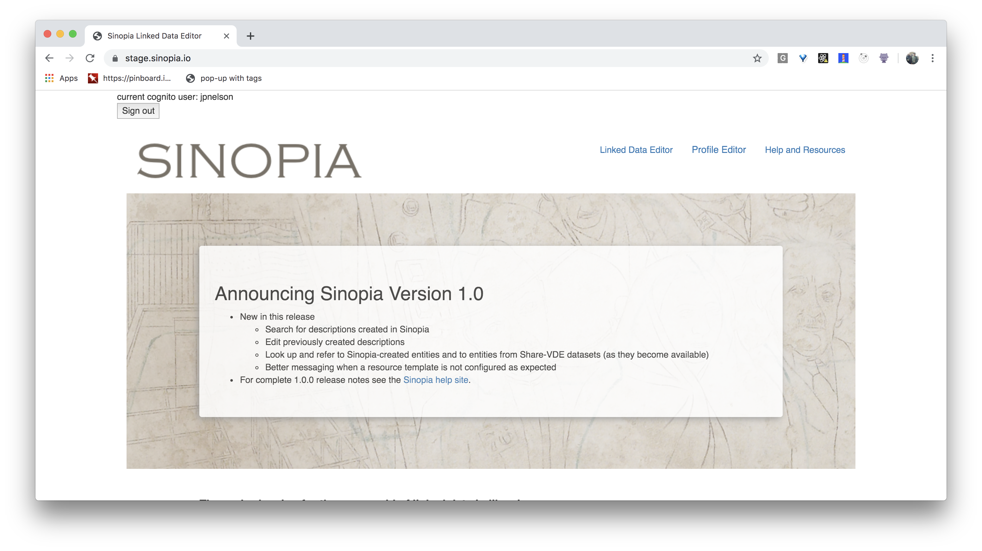
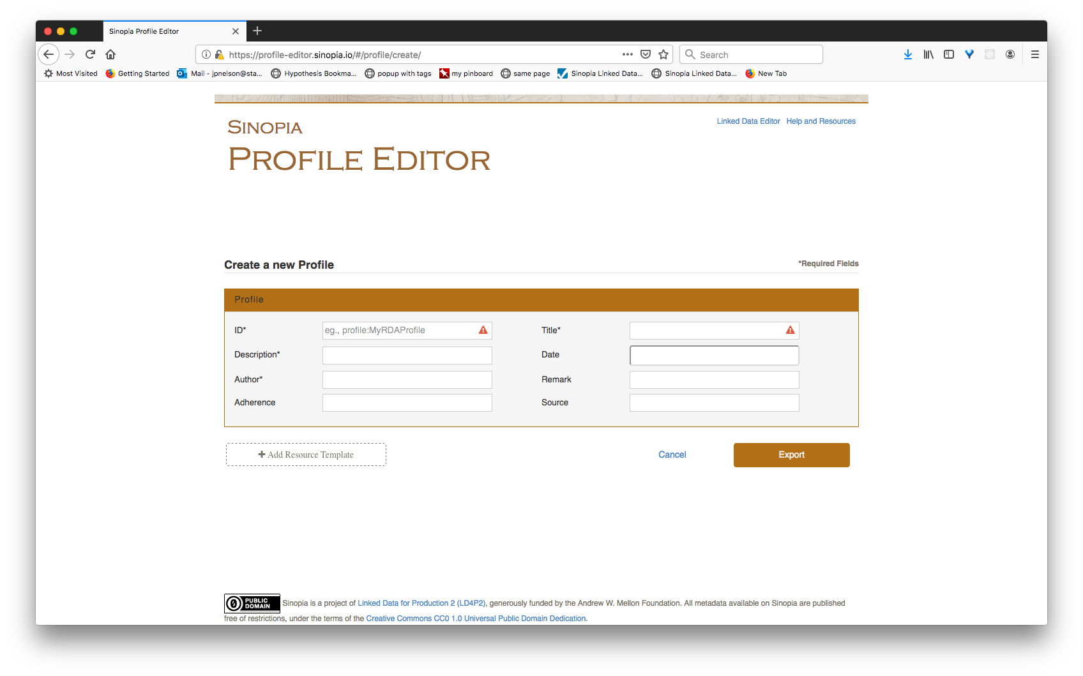
Sinopia Stack
v1.0.0
Linked Data Editor (React/Redux Client App)
Profile Editor (Angular 1.0 Client App)
Read
sinopia-pe
Amazon Cognito
sinopia-homepage
sinopia-indexing
JWT for Create, Update, Delete
Trellis DB
Amazon MQ

